Slide 1
OUR DESIGN THINKING JOURNEY
Batch [ ], Group [ ]
[Date Goes Here]

Slide 2
Today’s Presentation
Introduction
Overview of the Project
Victories
Struggles
Self-Assessment

Slide 3
1. Introduction
Our Design Thinking Journey

Slide 4
Our project
Introduce yourself and your team members
Give the name and the goal of the project
Explain very briefly (just a few words!) what you will cover in each of the sections of your presentation.

Slide 5
2. Project Overview
Our Design Thinking Journey

Slide 6
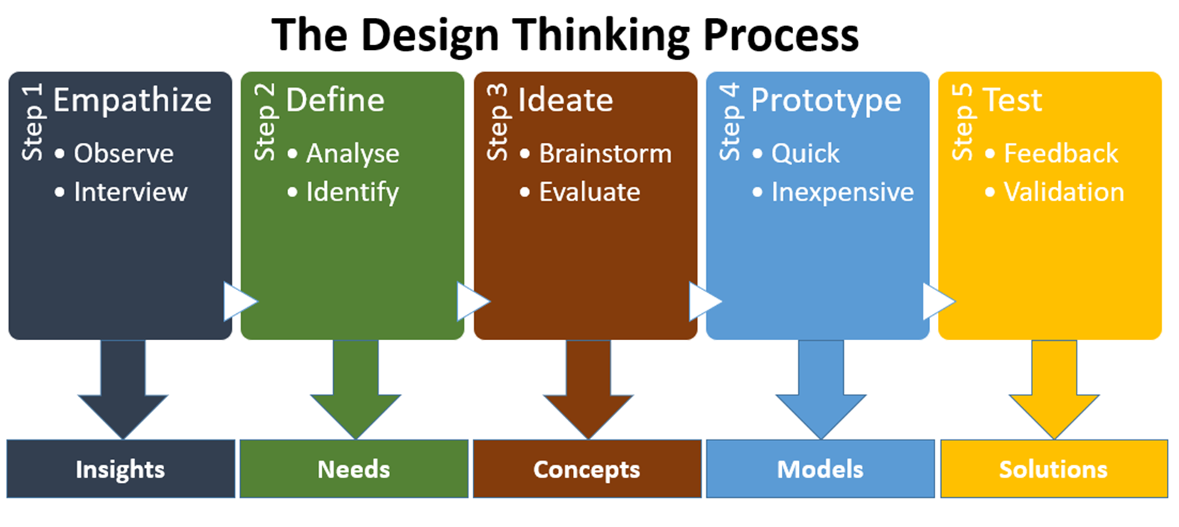
Overview of our work
Give the steps you took in your project. Use multiple slides if you wish. Make sure to include the infographic that shows the five steps in the Design Thinking process.
Give a description of the work you did during each step
The tasks you completed
Some numbers, such as how many students participated in a task, number of customer journey maps produced, number of ideas listed, number of prototypes created, etc.
Your work product from each task. What did you create and submit?

Slide 7
3. victories
Our Design Thinking Journey

Slide 8
We did some things well
You are free to list and describe any tasks you think your group did well.
You may use one slide for each such task
You may add an illustration to any slide in this section.
You should explain why you were able to do each task well.

Slide 9
4. struggles
Our Design Thinking Journey

Slide 10
AND some things not as well
You are free to list and describe any tasks you think your group struggled with.
You may use one slide for each such task.
You may add an illustration to any slide in this section.
You should explain the reason why you were unable to do as well as you hoped.

Slide 11
5. Self assessment
Our Design Thinking Journey

Slide 12
Our honest self-rating
You are free to discuss any elements of your group’s performance in this course.
Examples include, but are NOT LIMITED TO, the elements listed below. Note that you DO NOT HAVE TO rate yourselves on any of these. You may choose.
Use this rating scale: unsatisfactory, satisfactory, good, excellent.
Sample elements (use none, some, or all of these, and include others if you wish)
Learning the theory of Design Thinking
Mastering the tools and methods of Design Thinking
Thinking critically about our work
Understanding and following directions carefully
Teamwork
Professionalism in behavior and in submitted work
Rate yourselves honestly. Your instructor will know if you are overrating yourselves.

Slide 13
Lessons learned
Describe what you learned in the course that you will remember and use later.
Describe in some detail. Don’t just give titles:
WRONG: We learned Prototyping
RIGHT: We learned how to make a rough prototype that communicates benefits and features
Remember the four learning outcomes for this course:
Understand the definition and process of Design Thinking and its implications in product or service development
Understand and analyse customers and their needs using Design Thinking tools and methods
Imagine solutions that will meet the needs of customers and create simple models of those solutions using Design Thinking tools and methods
Evaluate solutions and refine them based on customer feedback using Design Thinking tools and methods.
Add a Thank You slide after this slide.

